Slide 1
Group 13
Presents

Slide 2
CHEF’S ZONE
The Culinary Specialist

Slide 3
Why CHEF’S ZONE ?
CHEF’S ZONE is a newly developed website based on recipes you want to search.
It offers Indian cooks at all skill level a dynamic and indispensable place to discover and share food online.
We also provide the users with authentic global insights into the kitchens and cooking passions of home cooks everywhere.

Slide 4
Unique Features
Search Recipe
Post Recipe
Ingredient Convertor
Language Translator
Update Profile
Multiple Cuisines
Feedback

Slide 5
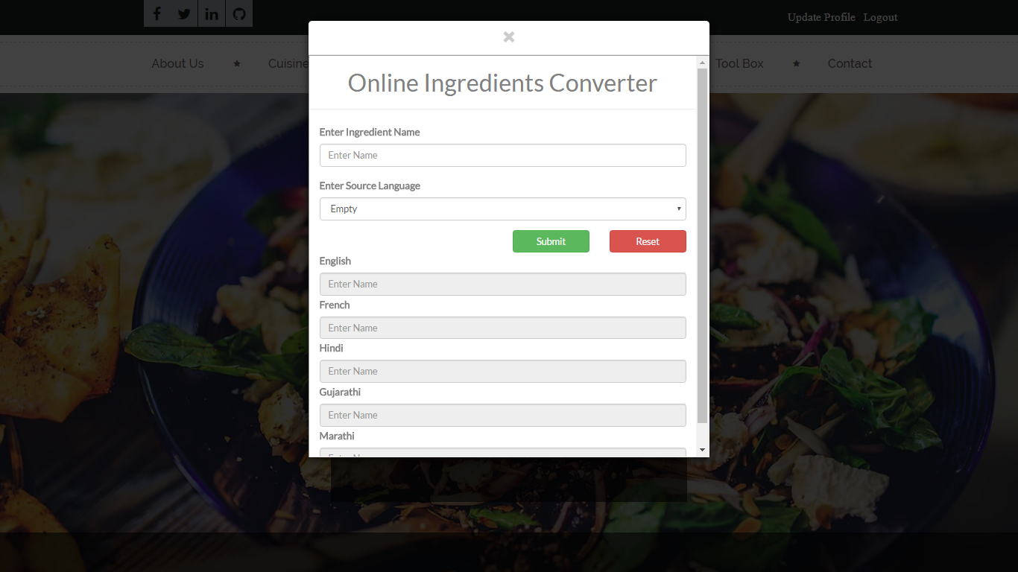
Modules
Language Translator

Slide 6
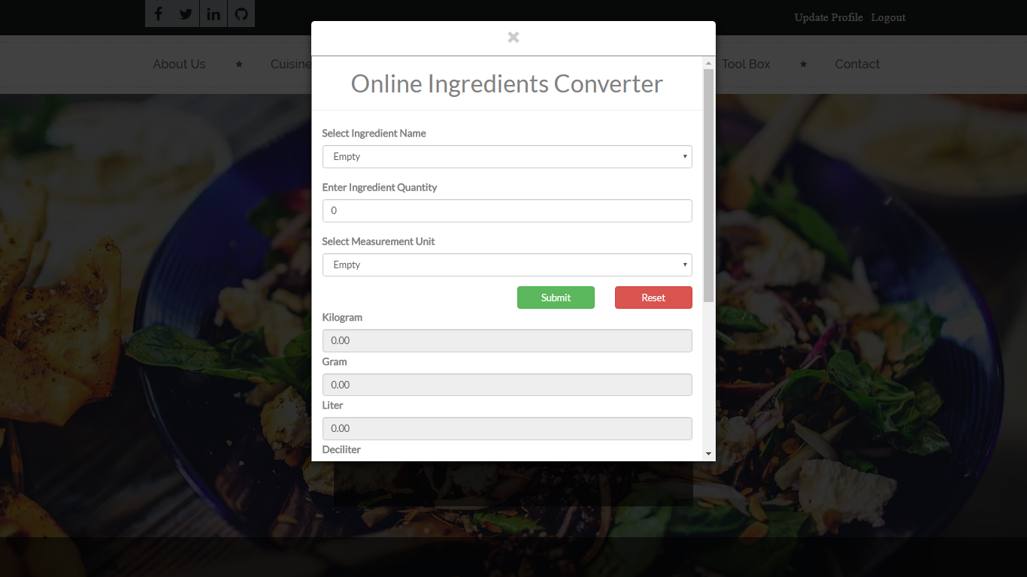
Modules
Ingredient Convertor

Slide 7
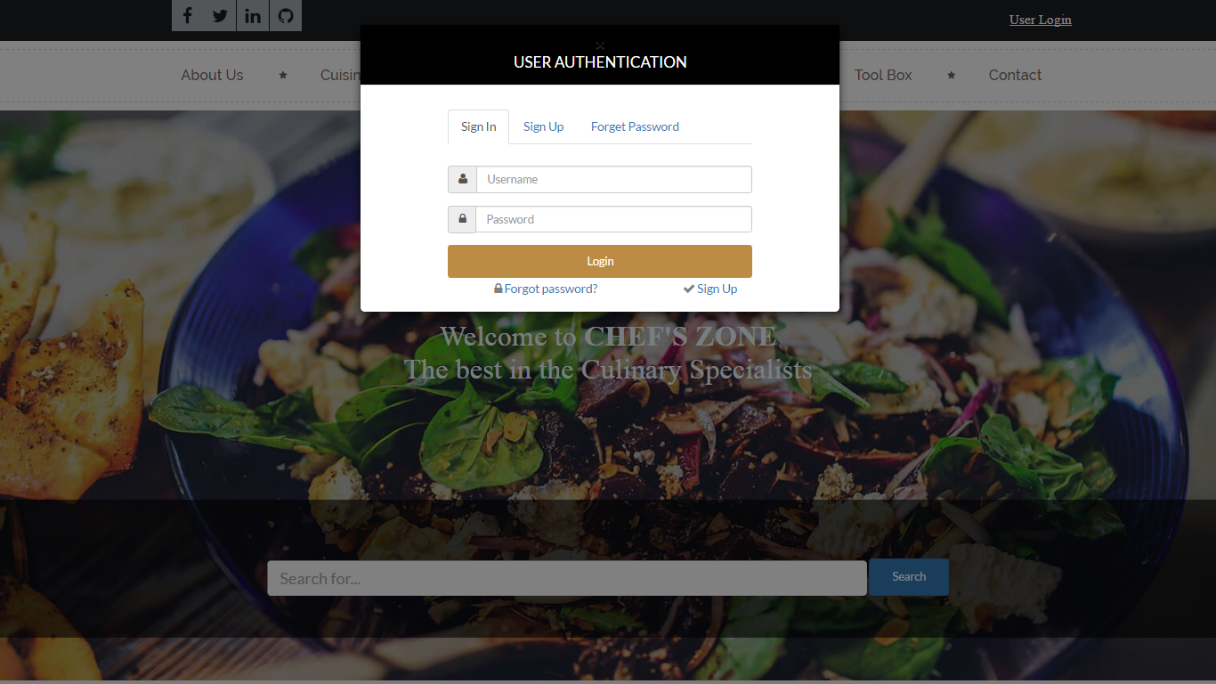
Modules
Login Modal

Slide 8
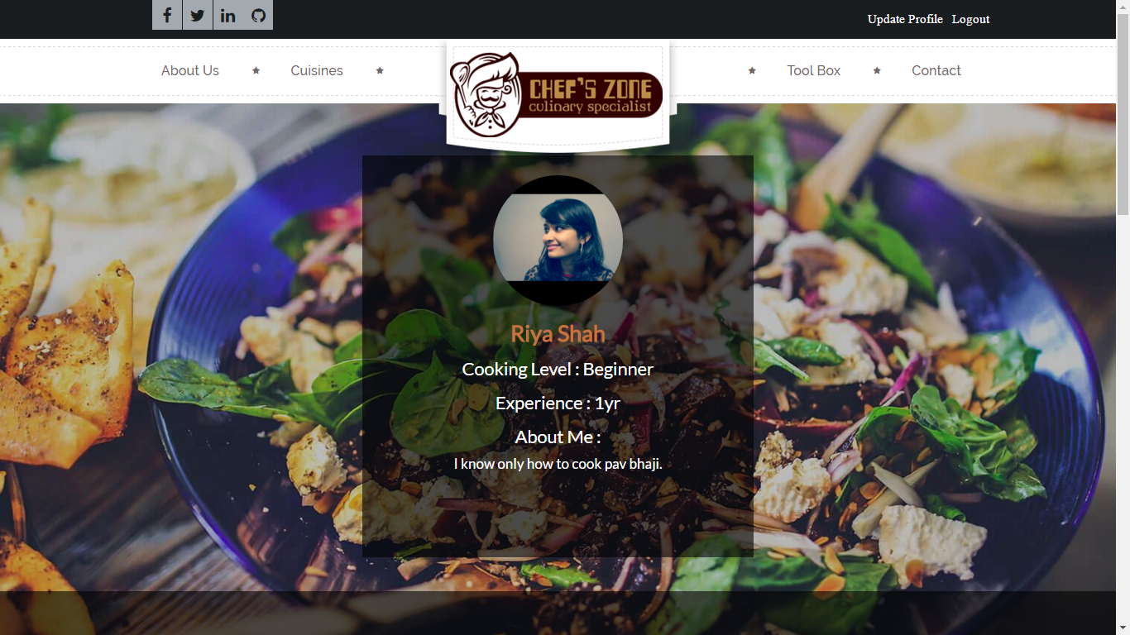
Modules
User Profile

Slide 9
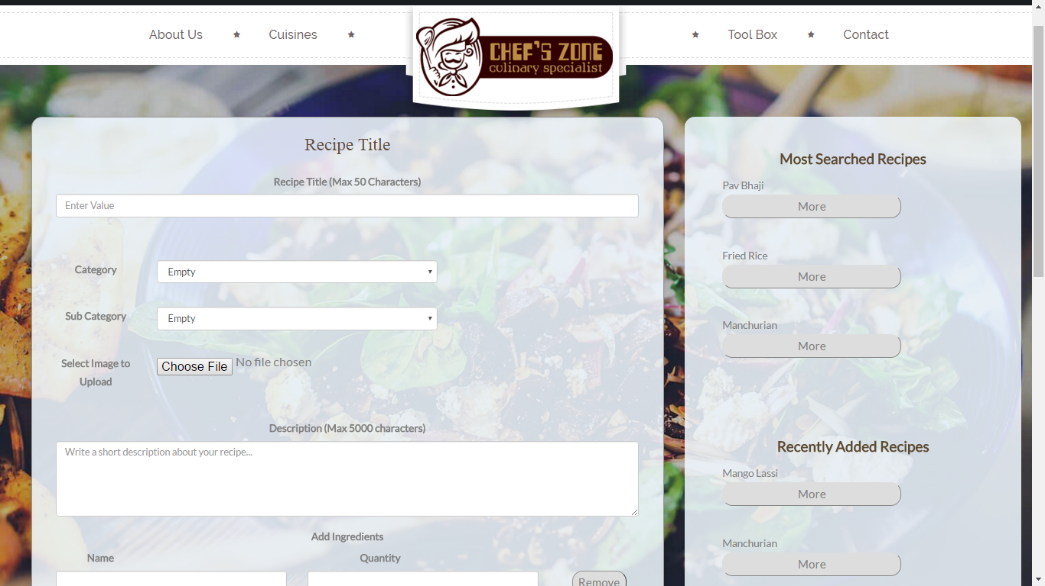
Modules
Submit Recipe

Slide 10
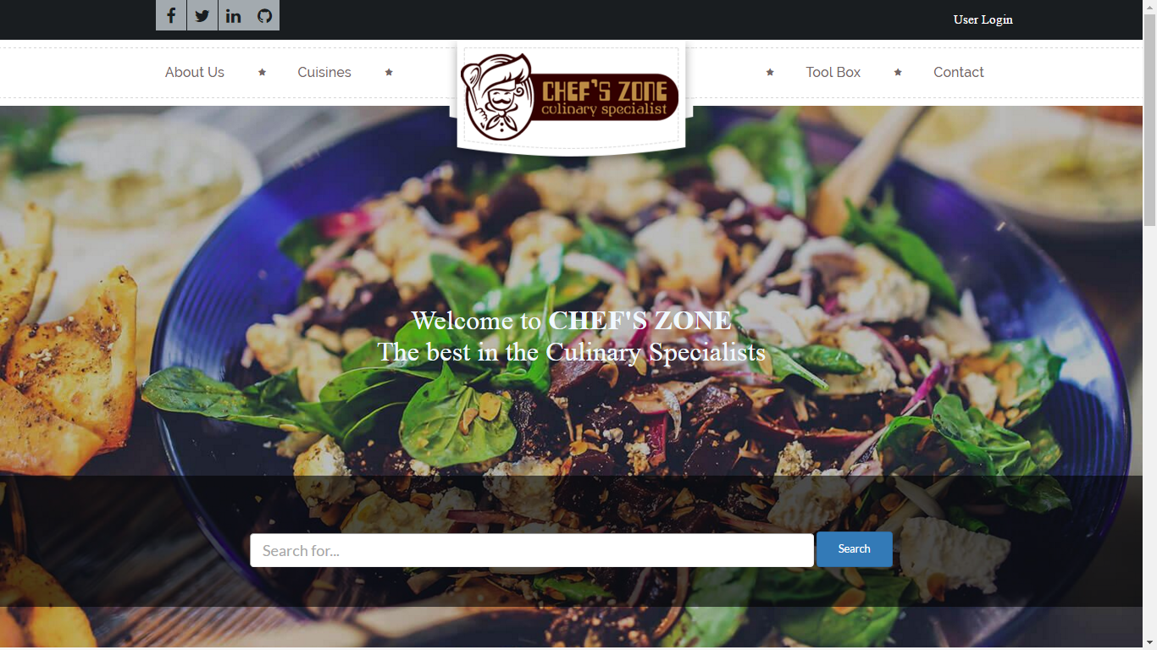
Modules
Search

Slide 11
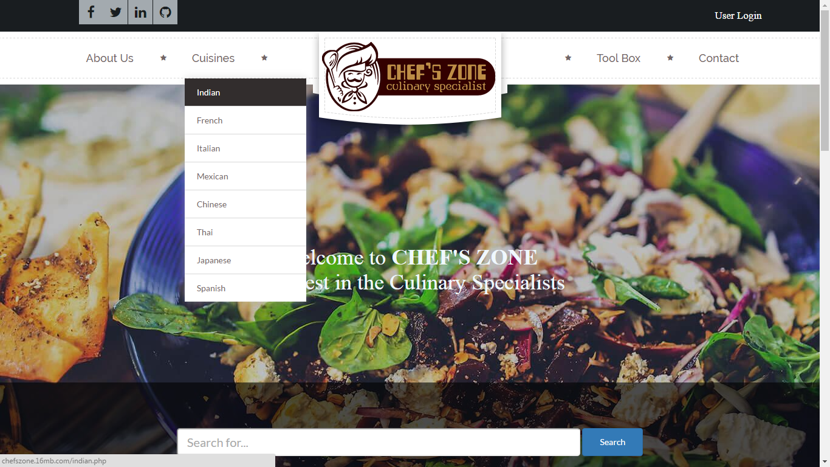
Modules
Multiple Cuisines

Slide 12
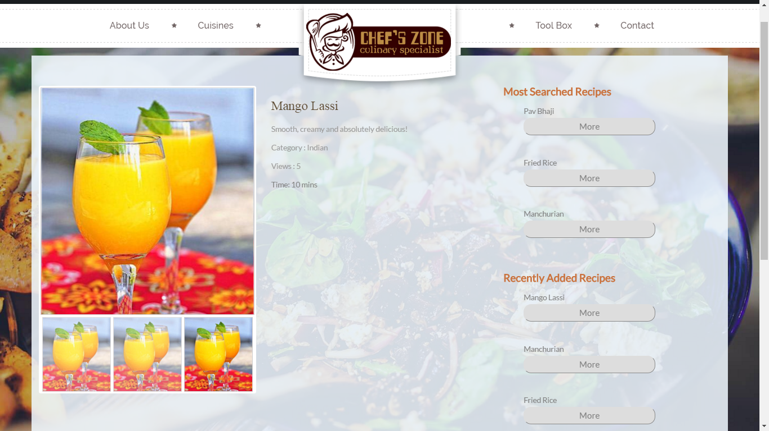
Modules
Single Cuisine

Slide 13
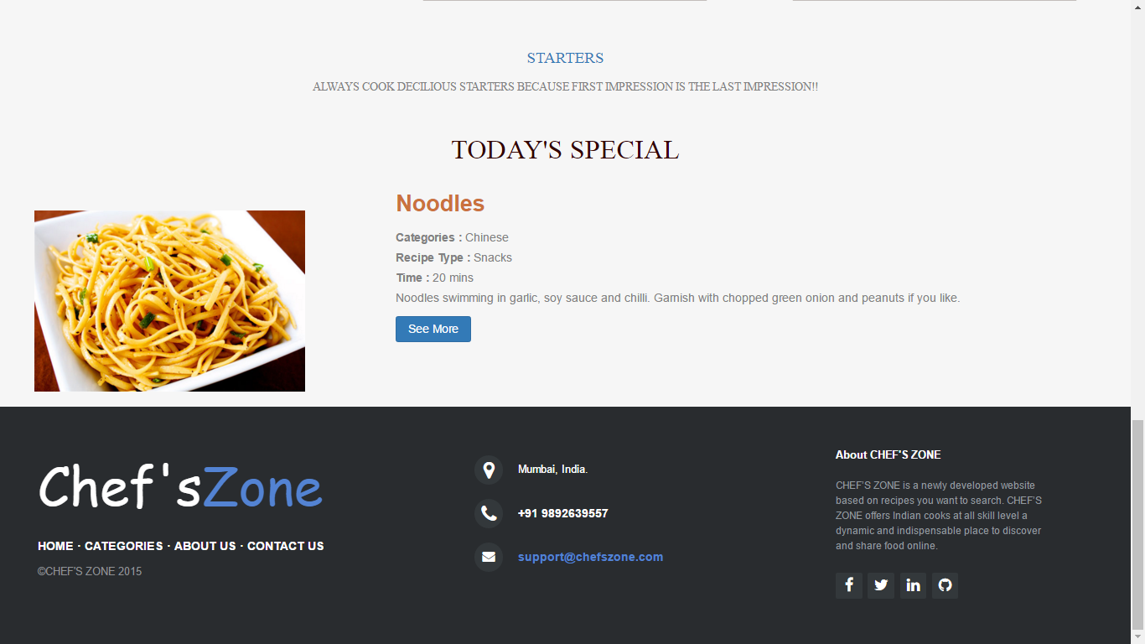
Modules
Today’s Special

Slide 14
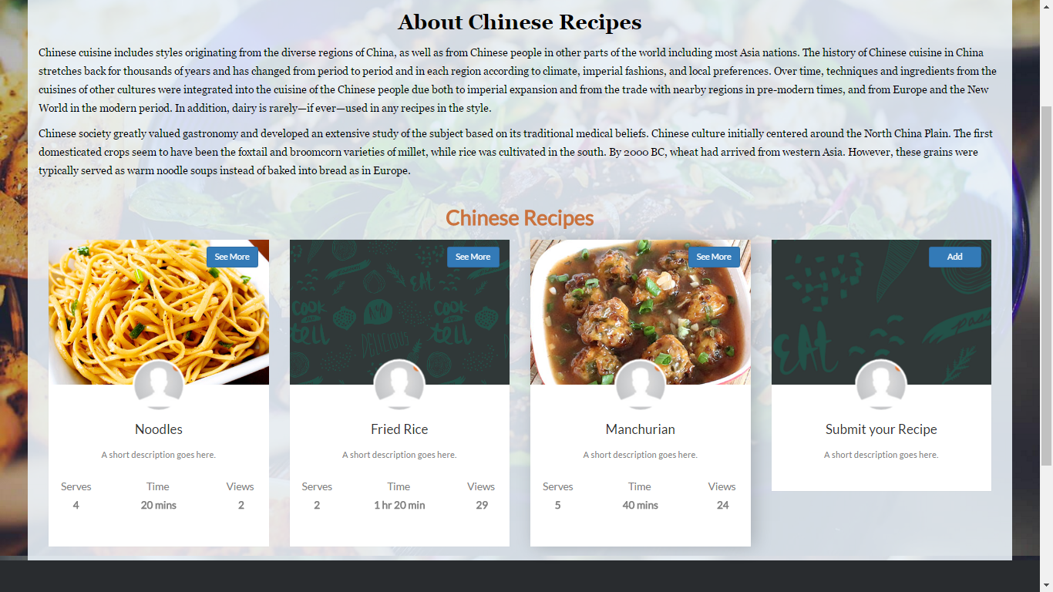
Modules
Add Recipe

Slide 15
Advantages
This project has a login page which allows only the registered user to login and thereby preventing unauthorized access.
This website can be used to view the recipes of all categories.
This innovative project allows users to share their recipes on the website as well as can share their reviews on particular recipes or rate that particular recipe.
This project also consists of toolbox which contains ingredient convertor and language translation.

Slide 16
Disadvantages
The user will not be able to access the website without the internet connection.
The website currently does not support video assistance.

Slide 17
Applications
The website can be proved to be very beneficial for food lovers and for those who keep on trying new dishes daily where they can upload the recipe of what they have made and can also their experiences.
This website can also be referred by the beginners who wish to make their careers in hotel management or any other course related to cooking.
This website can also be used to cook anything possible from left over ingredients.

Slide 18
Future Enhancement
Video Uploading
Notifications
Better Navigation
Mobile Application

Slide 19
Bibliography
www.recipematcher.com
www.w3schools.com
www.bootstrap.com
Tutorials point for php
Video tutorials on YouTube for learning PHP and Bootstrap.

Slide 20
About Us
DEVELOPED BY:
SAGAR UMESH PARMAR [1398026]
AKASH KETAN SHAH [1398035]
RIYA JATIN SHAH [1398037]
CONTACT US AT:-
sagarparmar4@gmail.com
shahakash2013@gmail.com
shahriya27021997@gmail.com

Slide 21
THANK YOU…

